Slide 1
What Is Information Security Risk ?
Risk is a fundamental concept that drives all security standards, frameworks, and activities
In simple terms, Information Security Risk refers to the potential damage or loss that may be caused to an organization in the absence of appropriate controls

Slide 2

What Is Information Security Risk ?
A process aimed at achieving an optimal balance between realizing opportunities for gain and minimizing vulnerabilities and loss
Usually accomplished by ensuring that impact of threats exploiting vulnerabilities is within acceptable limits at an acceptable cost
REF: ISACA CISM MANUAL

Slide 3
What Is Information Security Risk ?
Risk is managed so that:
It does not materially impact the business process in an adverse way
Acceptable level of assurance and predictability to the desired outcomes of any organizational activity
REF: ISACA CISM MANUAL

Slide 4
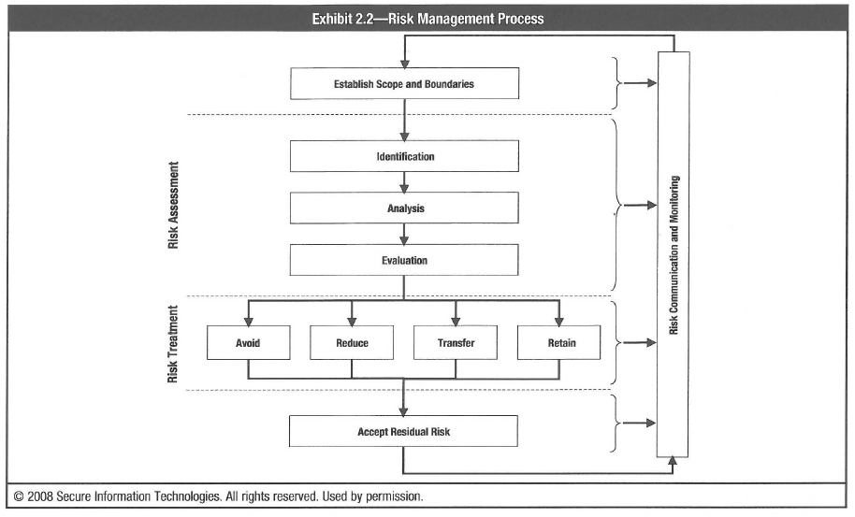
What Is Information Security Risk ?
REF: ISACA CISM MANUAL

Slide 5
What Is Information Security Risk ?
Risk Assessment:
Foundation for effective risk management
Solid understanding of the risk universe
Nature and extent of risk to IT resources and potential impact on organizations activities
REF: ISACA CISM MANUAL

Slide 6
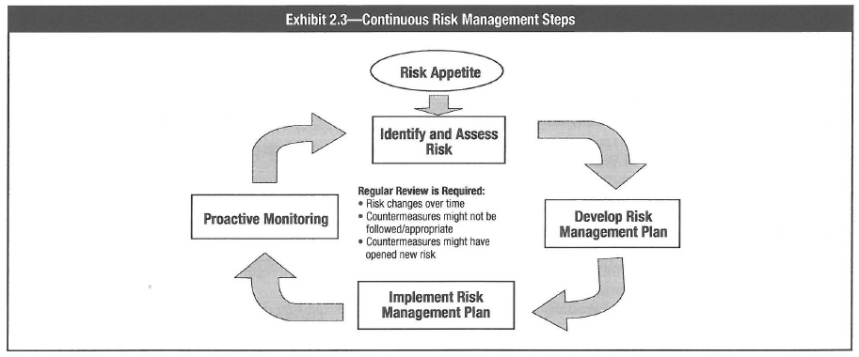
What Is Information Security Risk ?
REF: ISACA CISM MANUAL

Slide 7
What Is Information Security Risk ?
Challenges with risk focused approach:
In an environment where controls are absent, a risk based approach may become too academic
Effort should focus on 4-Step Security Transformation Framework

